Slide 1
Paper 1 - Theory (Chapter 8)
Exam Questions and Answers
Guidance:
0417/11 (2013)
0417/12 (2013)
0417/13 (2013)
0417/11 (2012)

Slide 2
Paper Paper 1 - Theory
Chapter 8 - 0417/11 (2013)
Iqbal wants to test the new computerised payroll system he would like to introduce to his company. No company worker is paid less than $100 and no worker is paid more than $500.
Explain what is meant by the following three types of test data using examples of the wages paid to workers.
Normal
Normal data – data within a (given) range/appropriate for that data type
Example – any wage between $100 and $500
Abnormal
Abnormal data – data outside the range/of the wrong data type
Example – any wage less than $100 or greater than $500 or text example
Extreme
Extreme data – data on the boundaries of the range
Example – $100 or $500
Example: Test Scores
0 – 100% (Range)
-10%
0%
5%
10%
20%
30%
40%
50%
60%
70%
80%
90%
95%
100%
110%
Boundary
R
A
N
G
E
Boundary

Slide 3
Paper Paper 1 - Theory
Chapter 8 - 0417/11 (2013)
Li has asked Sharon, a systems analyst, to create a new database system for his computer store. He only sells computers made by ZIKO. Here are some of the questions customers ask:
“Have you got a computer with a hard disc which stores more than 1000 Gigabytes?”
“Have you got a laptop which has a separate number pad?”
“Have you got a PC which costs less than $500?”
(a) Complete the data dictionary below filling in the field names and the most appropriate data types to create a database which would answer these questions.
Tip:
Look at the requirements of the database. What type of information is required. From each bullet create a field name.
Common Mistakes:
Some students may write $500 as the field name instead of Cost.
Field name | Data type
Hard_disc_size | Integer
Separate_Number_Pad | Boolean
Cost | Currency
Type_of_Computer | Boolean

Slide 4
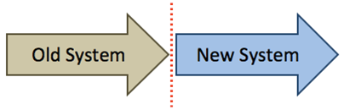
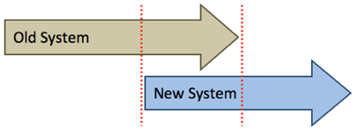
Paper Paper 1 - Theory
Chapter 8 - 0417/11 (2013)
Explain the differences between parallel running and direct changeover as ways of
implementing the new database.
Direct changeover – new system replaces existing system immediately/overnight
Parallel running – new system runs alongside/together with existing system
Parallel running – there is always the old system to fall back on in the event of the new
system failing/information is not lost/always a second copy
Direct changeover – if things go wrong lose all data/old system is not available
Direct changeover – training is more difficult to organise
Parallel running – training can be gradual
Parallel running is more expensive to implement than direct changeover....
Direct changeover is a quicker method of implementation than parallel running
 | Direct Changeover: The old system is stopped completely, and the new system is started. All of the data that used to be input into the old system, now goes into the new one.
 | Parallel Running: The new system is started, but the old system is kept running in parallel (side-by-side) for a while. All of the data that is input into the old system, is also input into the new one. Eventually, the old system will be stopped, but only when the new system has been proven to work.

Slide 5
Paper Paper 1 - Theory
Chapter 8 - 0417/12 (2013)
Chi has employed Sarbjit, a systems analyst, to create a new database system for his
mobile telephone (cellphone) business.
• He keeps a number of different models in stock.
• Most of the phones have a camera but some do not.
• The rental plans have 100, 200 or 500 free texts depending on the amount the
customer pays per month.
• The minimum monthly payment is $10 and the maximum is $100.
(a) Complete the data dictionary below filling in the field names and the most appropriate
data types to create a database using only the above information.
Field name | Data type
Model | Text
Camera | Boolean
Free texts | Integer
Monthly payment | Currency
Camera is set as Boolean because it can only be a Yes or a No.

Slide 6
Paper Paper 1 - Theory
Chapter 8 - 0417/12 (2013)
Name and describe three different validation checks that could be used on the data in
this database. (refer to the last slide)
Range check on Monthly payment
No less than $10, no more than $100
(Invalid) character/type check on ‘Free texts’ field
Only digits allowed
Presence check on any field
To make sure data has been entered in that field
Field name | Data type
Free texts | Integer
Monthly payment | Currency
Tip: Validation makes sure the correct data is entered into the correct field.
Presence Check | Is data actually present in a field, or has it been missed out?
Range Check | Is the data value within a set range? (E.g. an exam mark should be between 0% and 100%, a month should be between 1 and 12)
Length Check | Is an item of text too short or too long?
Type Check | Is the data the correct type? (E.g. the letter ‘A’ should not be allowed in a numeric field)
Format Check | Is the data in the correct format? (E.g. a date of birth should be entered as dd/mm/yyyy)

Slide 7


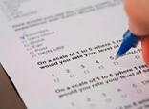

Paper Paper 1 - Theory
Chapter 8 - 0417/12 (2013)
A company wishes to replace its current system with a new computerised system. It has employed a systems analyst to investigate the current system.
Describe three methods the systems analyst could use to research the current system.
Observing the users using the current system
Questionnaires are distributed to users asking questions about the current system
Interviewing the users about the current system
Examining documents from the current system
Observation | This involves the systems analyst walking around the organisation or business, watching how things work with his/her own eyes.
Interview | The systems analyst can interview key people within the system to find out how it works. Interviews allow lots of very detailed information to be gathered, but they take a long time to do, so are not possible if large groups of people are involved.
Questionnaires | With large groups of people, a questionnaire is a quick and simple way to gather information.
Collecting Documents | The systems analyst needs to collect examples of the documents used to get an understanding of the type and quantity of data that flows through the business or organisation.

Slide 8
Paper Paper 1 - Theory
Chapter 8 - 0417/12 (2013)
When large volumes of data are input to a new system it is usual to carry out verification
and validation on this data.
(b) Name and describe two methods of verification which could be used
Visual verification/checking (Proof Reading)
Read through data on screen and compare with source document
Double data entry
Data is typed in twice by one typist
Computer compares versions
To check that data is the correct value, we use a system called data verification.
Proof Reading: After the data has been entered a person compares the original data with the data in the computer
Double Entry: The data is entered into the computer twice. The computer compares the two sets of data to see if they match. If not it generates an error and a person will need to correct the mistake.
Example: Setting new Passwords

Slide 9
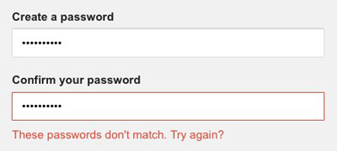
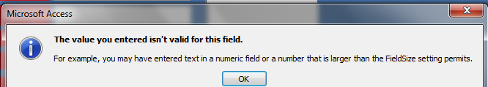
Paper Paper 1 - Theory
Chapter 8 - 0417/12 (2013)
Explain why it is necessary to carry out validation even though the data has been
verified.
Source document may contain errors
Verification only checks that data is copied correctly
Verification does not check if data is reasonable/sensible
A correct explanation of an example of one validation check
Tip: When you are asked to create a new password the validation may ask you to include the following components:
Letters and Numbers
One Uppercase letter (Capital letter)
Minimum characters (6)
This Password will not work: apple
This Password will work: Apple123
Verification will only check if the two passwords match when using double entry.

Slide 10
Paper Paper 1 - Theory
Chapter 8 - 0417/13 (2013)
Davina has asked Boris, a systems analyst, to create a new database system for her zoo.
She keeps animals of all types. Here are some of the questions that visitors to the zoo ask:
What is the name of the female lion you have?
How heavy is Jumbo the elephant?
How much does it cost to adopt a tiger?
(a) Complete the data dictionary below filling in the field names and most appropriate
data type to create a database which would answer these questions.
Species – Type of Animal
Field name | Data type
Name | Text
Gender | Boolean
Species | Text
Weight (kg) | Numeric
Adoption Cost | Currency
Gender: You would have to write one Gender (Male or Female)
Example:
Male (Yes or No)
or
Female (Yes or No)

Slide 11
Paper Paper 1 - Theory
Chapter 8 - 0417/13 (2013)
Boris will provide two types of documentation when the system is implemented.
Name each type of documentation and for each one give two items which would be
included.
User Documentation How to load software/install/run software How to save a file How to search How to sort How to print How to add records How to delete/edit records Tutorials Troubleshooting guide/Contact details/help line/FAQ | Technical Documentation File structure Purpose of the system/program Hardware requirements Software requirements Known bugs/possible errors (Trouble Shooting) Validation rules Limitations of the system

Slide 12
Paper Paper 1 - Theory
Chapter 8 - 0417/11 (2012)
After collecting information, Louise noticed that Mario sells both non-fiction and fiction
books in hardback and paperback. She also discovered that no books cost more than $20.
She wrote down some of the questions that customers ask, such as:
Have you got any non-fiction books by Arthur C Clarke?
Have you got the hardback version of ‘Harry Potter and the Philosopher’s Stone’?
Have you got any books for less than $10?
(b) Complete the design table below filling in the field names and most appropriate
validation checks to create a database which would answer these questions.
Field name | Validation Check
Book Title | None
Author | None
Price | Range check
Fiction/Non-Fiction | Boolean
Hardback/Paper back | Boolean
You would only write Fiction or Non-Fiction (not both). The same with Hardback/Paper Back
Example:
Fiction (Yes or No)
Hardback (Yes or No)

Slide 13
Paper Paper 1 - Theory
Chapter 8 - 0417/12 (2012)
Paul is the headteacher of a school. He has employed Mary, a systems analyst, to create a
new database system to store records of his students. Here are some of the questions that Paul might want to answer using the new database system:
Which class is Steven Jones in?
What are the first names of male students in class 11S?
How many IGCSEs is Sara Patel taking?
No student takes more than 10 IGCSEs.
(a) Complete the design table below, filling in the field names and most appropriate
validation rule which could be applied to each field.
Field name | Validation Check
First Name | none
Surname | none
Class | length
Gender | Boolean
Number of iGCSEs | Range
Typical records would be:
Peter Ngong, 11S, 10, M ,
Joan Murugo, 11R, 9, F ,
Francis Uhuru, 11S, 9, M ,
Susan Mathu, 11T, 10, F

Slide 14
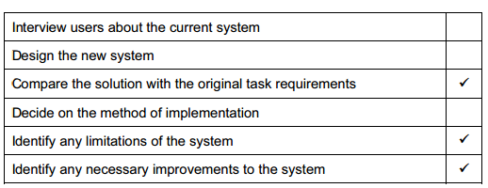
Paper Paper 1 - Theory
Chapter 8 - 0417/12 (2012)
(c) After the new system has been implemented it will be evaluated.
Tick three activities which Mary will need to carry out as part of the evaluation.
This two options are at the start of the systems analysis life cycle.
The System has already been implemented.

Slide 15
Paper Paper 1 - Theory
Chapter 8 - 0417/13 (2012)
Anya has employed Raymond, a systems analyst, to create a new database system for sports day at her school. Here are some of the questions teachers and students might ask about the results of the athletics competition:
What position did Peter Njoka come in the 100 metres?
Who won the 1500 metres?
The winner of the 800 metres was wearing which Race ID?
Each athlete wore a Race ID consisting of one letter followed by three digits. The longest race is the 1500 metres.
(a) Complete the design table below filling in the field names and the most appropriate
data types to create a database which would answer these questions.
Field name | Data Type
Race ID | Text
Race_length | Integer
Name | Text
Position | Integer
Tip: The Race ID consists of letters and number so that why the data type is set as Text.

Slide 16
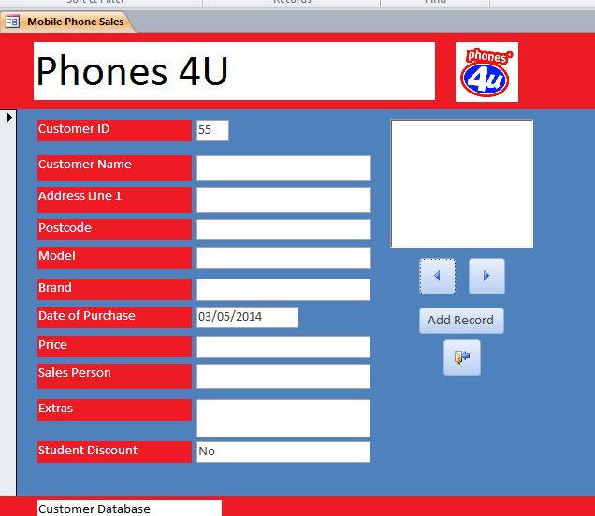
Paper Paper 1 - Theory
Chapter 8 - 0417/13 (2012)
Name and describe the most appropriate validation check which would be carried out on the Race_ID field.
Validation Rule: Each athlete wore a Race ID consisting of one letter followed by three digits. The longest race is the 1500 metres.
Checks the data is of the format beginning with a letter and ending in three digits and is only
four characters long.
Anya wants to have a system which will make it easy to enter data.
Describe five features of a well designed input screen.
Appropriate spacing for each field
Buttons to go forward/backwards
Screen filled/not too much white space
Drop down lists to choose an option (such as race length)
Button to save data/submit/accept
Clearly defined input area for each field
Tick boxes/radio buttons to enter choices
An easy to read font/font size
A sensible font colour/background colour
Easy to follow instructions for completing screen/help icon
No overlapping of items

